Slide 1
AVIATION DATASET ANALYSIS by Calvince Kaunda

Slide 2
Business Problem and objectives
Our company is entering aviation industry to operate planes for private and commercial use but the company lacks understanding of the risks involved in aircraft operations
Our task is to analyze the dataset and identify lowest-risk aircraft types for the company to consider.

Slide 3
Data understanding and exploration
I did the analysis using the pandas library and found out some features about the data
Our dataset has 88889 rows and 31 columns
Not all columns are necessary for out analysis.
I will first clean and filter our data
The data consists of missing values and values which are irrelevant to the analysis

Slide 4
DATA ANALYSIS
Necessary columns I needed for analysis include :investigation type, aircraft category, aircraft damage and injury severity
Other columns were dropped together with missing values or irrelevant values
The analysis included finding distributions of aircraft types with aircraft damage, investigation type and injury severity
Data was grouped into various categories using groupby functions and applying multiple filters to our data

Slide 5
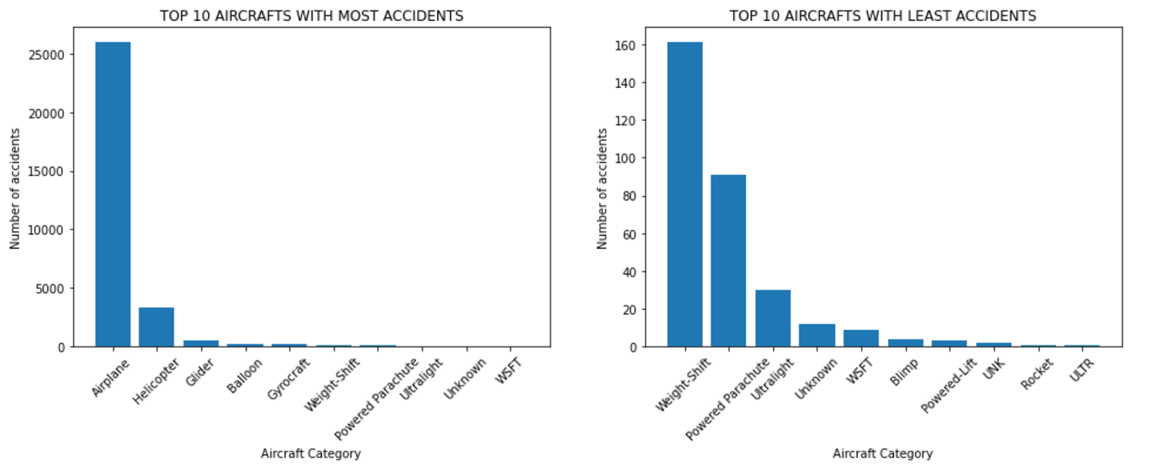
FINDINGS
Airplanes and helicopters have the most accidents BUT Rockets and ULTRs have the least accidents

Slide 6
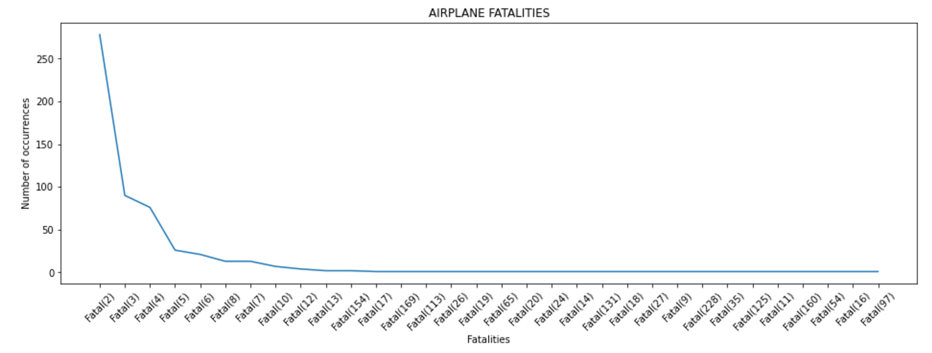
FINDINGS
Airplanes have the highest non fatalities occurrence of more than the other aircrafts(above 20000)

Slide 7
CONCLUSION
Airplanes have the highest fatality occurrences with an average of 17 followed by helicopters with an average fatality occurrence count of 7.
They however also have the highest count of non fatalities followed by helicopters. Airplane count is up to 9 times of helicopter count.
Aircrafts with least numbers of accidents DO NOT have any non fatalities values indicating all accidents are fatal

Slide 8
RECOMMENDATIONS
Hence, I would recommend Airplanes for entry into business as this is the aircraft with the highest number of non fatalities, hence quite safe for consumers.
The risk being considered here is in terms of the non-fatalities
If the risk being considered is in terms of damages I would recommend balloons as the have the least damages while airplanes have the most however accidents here result in fatalities only

Slide 9
THANK YOU Any Questions?
Contacts:
Calvince Kaunda
Visit my GitHub and LinkedIn

